Slide 1




NEXT GEN EMPLOYABILITY PROGRAM
Creating a future-ready workforce
Team Members
College Name
Student Name : K.Jelsiya
Student ID : au951221104015
JP College Of Engineering

Slide 2

CAPSTONE PROJECT SHOWCASE
Project Title
Voting Web Application using Django Framework
Abstract | Problem Statement | Project Overview | Proposed Solution | Technology Used | Modelling & Results | Conclusion

Slide 3
Abstract
A voting web application using the Django framework could include models for users, polls, and choices. Users could vote on different choices within polls, with the application calculating and displaying the results. The abstract structure might involve creating models for users, polls, and choices, along with views for displaying the polls, handling user authentication, and processing votes. Additionally, templates would be needed for rendering the user interface, and forms for capturing user input. Django's built-in admin interface could be utilized for managing polls and choices.
Source :

Slide 4
Problem Statement
Develop asecureand user-friendly web application using Djangoframework that allows registered users toparticipatein various voting processes, such as polls, surveys, or elections.Theapplication should ensuretheintegrity of votes, providean intuitiveinterfacefor both administrators and users,and includefeatures for authentication, authorization, and result visualization.
Source :

Slide 5
Project Overview
Project Overview: Building a Django-based voting web app for secure and user-friendly online polls. Features include user authentication, customizable polls, real-time results, data analysis, and admin dashboard for management Prioritizing security, accessibility, and scalability.
Project setup
App creation
Database models
Admin interfaces
User authentication
Poll creation
Voting and results display
Frond end design and URL routing
Testing and deployment

Slide 6
Proposed Solution
.
• Utilize Django built-in authentication system for user registration, login, and logout functionalities. Customize authentication views and templates as needed Implement views and templates for displaying candidates and allowing users to cast their votes.
Ensure that each user can only vote once and hand potential errors or edge cases.
Register models with Django's admin interfacet allow administrators to manage candidates, voters, and votes easily
Customize admin views and templates for better usability if necessary.
Source :

Slide 7
Advantages
Django's built-in features like authentication, URL routing, and templating system allow for quick development of complex web applications.
Django for web applications offers rapid development, scalability, strong security features, an supportive community, versatile capabilities, an ORM for data base interactions, built-in admin interface, reusable components, SEO-friendliness, and a mature, stable frame work.
web applications is its extensive built-in features and batteries-included approach, which reduces the need for external dependencies and simplifies development by providing all the essential tools within theframe work itself.
Django is versatile and can be used to build a wide range of web applications, from simple blogs to complex e-commerce platforms, including voting systems.
Source :

Slide 8
Disadvantages
Learning curve: Django has a learning curve, especially for beginners or developers who are not familiar with Python or MVC (Model-View-Controller) frameworks. It may take time for developers to become proficient in Django's concepts and conventions.
For a voting web application, one disadvantage of using Django could be the need for real-time updates or live data synchronization, which might require additional configuration or third-party tools as Django is primarily designed for request-response model rather than real-time data handling.
voting web application is the potential for scalability challenges, especially if the application experiences sudden spikes in traffic during voting periods. Managing and scaling the application to handle increased load may require additional resources and expertise.
Source :

Slide 9




Technology Used
Front-end
Back-end
Source :

Slide 10
Modelling & Results
In developing a voting application using Django, meticulous attention is directed towards both modeling the underlying data structure and effectively presenting the voting results to users.
Through Django's model system, the application's data architecture is meticulously crafted, typically featuring models like Question and Choice to represent the polls and available choices.
Once users have participated in the voting process, conveying the results to them becomes paramount.
Leveraging Django's templating system, the application dynamically generates HTML templates that vividly present the voting outcomes in an intuitive and visually engaging manner.
Furthermore, the application may utilize charting libraries or custom visualization techniques to elucidate the distribution of votes across different options, offering users valuable insights into the voting process's outcome.
Source :

Slide 11
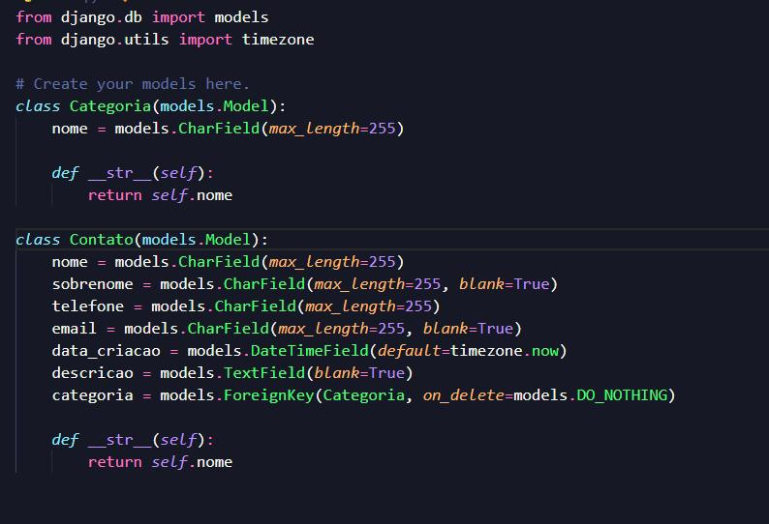
Homepage

Slide 12
About-Us-Page
1.Credibility: The "About Us" page establishes credibility by providing informationabout the organization's history, mission, and team members .
2.Mission and Values: It communicates the organization's mission, values, and objectivesin promoting democratic participation and decision-making.
3. Community Engagement: The page showcases the organization's commitment tocommunity engagement and empowerment through the voting process, inspiring active participation.
4. Contact Information: Users can easily reach out with questions, feedback, or inquiriesabout the voting application through the contact information provided on the page.

Slide 13
Service-Page
Header Section
Introduction section
User Services
Administrator Services
Organizational Services
Technical Services
Consulting Services
Call to Action Services

Slide 14
Departments-Page
Header Section
● Introduction Section
● Department Listings
● Department Details
● Key Personnel
● Collaboration Opportunities
● Footer Section

Slide 15
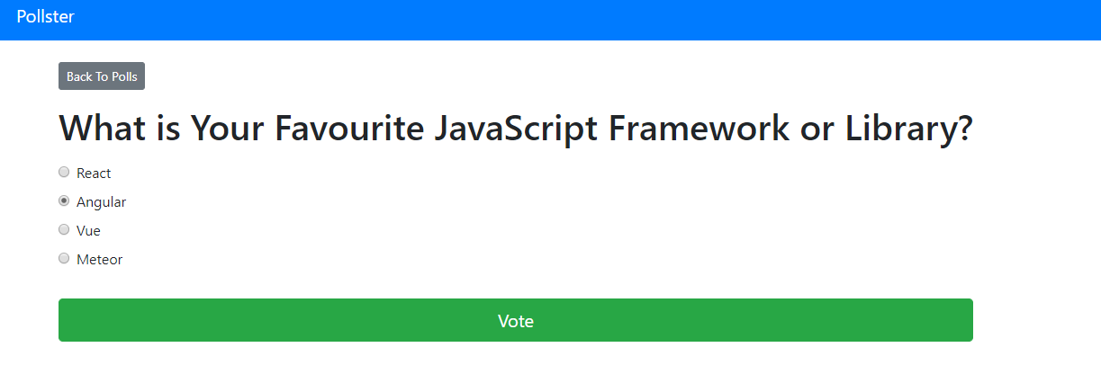
Blog-Page

Slide 16
Future Enhancements:
Utilize machine learning algorithms to analyze voting data, predict future trends, and provide personalized recommendations for users based on their voting history and preferences
Extend the voting application's reach by developing native mobile apps for iOS and Android platforms, offering a seamless and optimized experience for mobile users.
Explore integrating blockchain technology to enhance the transparency, security, and integrity of the voting process, ensuring that votes are immutable and tamper-proof.
Implement comprehensive reporting functionalities for administrators to generate detailed reports on voting patterns, demographics, and trends. This could include visualizations such as charts and graphs.

Slide 17
Conclusion
while Django offers numerous advantages for web development, including rapid
development, security, and scalability, it may present challenges for certain applications such as a voting web application
Potential disadvantages include the need for real-time updates and scalability issues during peak usage periods. Despite these challenges, with careful planning and optimization, Django can still be a viable framework for building a robust and secure voting web application.
Source :

Slide 18
Thank You!
Notes:
Thank You !!

